Slide 1

OLIST BRAZILIAN E-COMMERCE SALES ANALYSIS
PRESENTED BY
SREELAKSHMI RAJU

Slide 2

INTRODUCTION
Brazilian E-Commerce platform
To analyse sales dataset
Convert raw data into meaningful insights
Create dashboard using Microsoft Excel

Slide 3
DATASET OVERVIEW
Dataset downloaded from Kaggle
Multiple Excel files
Imported and merged into Excel
Merged into one dataset using power Query
16 Columns and 118435 Rows

Slide 4
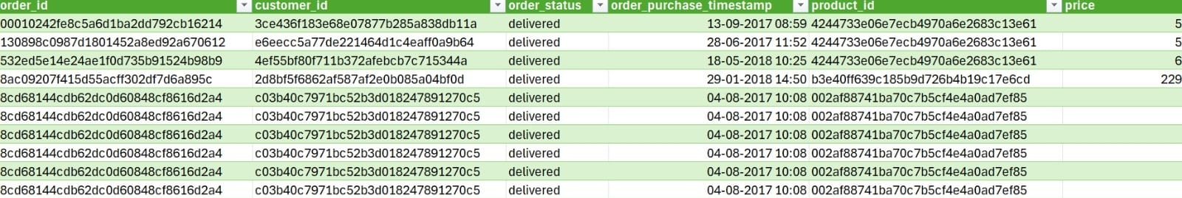
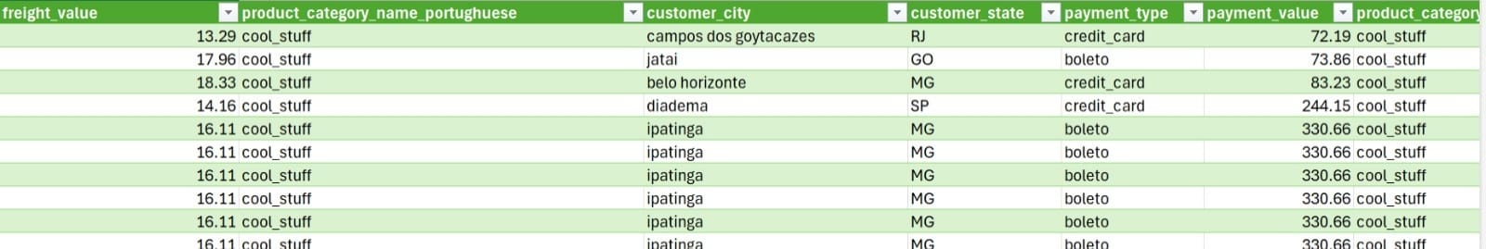
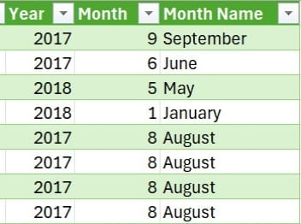

Slide 5
OBJECTIVE
Import multiple datasets into Excel
Power Query to clean , transform and merge
Added extra columns
Analyse important business metrics
Built interactive dashboard with KPI cards , charts and Slicers.

Slide 6
INSIGHTS
2018 generated the highest revenue
Sales fluctuated throughout the year
Few months noticed higher revenue
Delivered orders for majority orders
Credit card mostly preferred
Watches & Gifts generated the highest revenue
Sao Paulo contributes highest revenue

Slide 7
CONCLUSION
Cleaned , transformed and merged datasets
Built interactive dashboard
Analysed sales performance, payment methods etc
Generated meaningful business insights
Strengthened practical skills in Excel dashboard development

Slide 8
FUTURE SCOPE
Develop dashboard in Power BI
Connect dashboard to a live database
Add profit and profit margin analysis
Implement customer segmentation
Build sales forecasting models

Slide 9
THANKYOU !

